Slide 1
Shift of centre of gravity of the evangelical church from West to the Majority world
A European response-Lessons from church history

Slide 2
1.The Early Church-AD 30-330
How did the early church grow from a despised minority into a significant and influential body?
*PROCLAMATION and DEMONSTRATION
‘They out-lived and out argued the pagans’. Adolf Harnack
They embraced and propagated the Gospel of Jesus Christ…and
They created attractive communities which engaged with the needs of the surrounding cultures eg.love in times of pandemic
(150 AD and 250-265 AD),
and the treatment of women-
See… ‘the rise of Christianity.’Rodney Stark

Slide 3
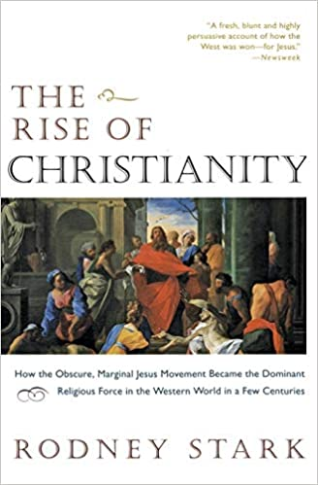

Slide 4
2.The Reformation.1517-1700
The Reformers(especially Luther and Calvin)
*REDISCOVERED THE ESSENCE OF THE GOSPEL.(especially justification by grace, the priesthood of all believers, and the centrality and authority of the Scriptures)
*REFORMED THE CULTURE- music, vocation, education, modern science, the visual arts, the birth of liberal democracy and much more.
See Into all the World ; the missionary vision of Luther and Calvin,Lindsay Brown.
*RECOVERED THE MISSIONARY VISION-missionaries sent all over Europe… Impact of the Diaspora
A Reformed and Revived Church needs to do all 3!

Slide 5
3.The Modern Era. 1750-2020
*Continued growth.1750- 1950 the MODERN MISSION ERA.
*AT THE SAME TIME!!- especially since 1850 we retreated from the growing intellectual challenges posed by the ENLIGHTENMENT and GROWING SECULARISM and retreated from engagement in the realm of ideas. We were perhaps overconfident, and failed to challenge the new liberalism head-on.. We failed to learn the lessons of The Early Church and The Reformation.
A failure to balance a desire to advance the Gospel in other countries with attempts to address challenges in our own culture. We must do both!
So..take heed lest you fall. Please learn from our strengths and our weaknesses.

